Slide 1



Data Science and Machine Learning
DEPLOYMENT ENVIRONMENTS

Slide 2

VIRTUAL ENVIRONMENTS

Slide 3

Virtual Environments (venv)
MyComputer
Pandas
numpy
Matplotlib
…
Requests
Tensorflow
Mlflow
Sckit-learn

Slide 4
Virtual Environments (venv)
MyComputer
Pandas=2.22.09
numpy
matplotlib
requests
BeatufiulSoup
Pandas=1.0.19
tensorflow

Slide 5
Virtual Environments (venv)
MyComputer
Pandas=2.22.09
numpy
matplotlib
requests
BeatufiulSoup
Pandas=1.0.19
tensorflow

Slide 6
Virtual Environments (venv)
Computer1
Pandas v2
Numpy v24
Matplotlib v3
Requests v7
Pandas v14
Numpy v5
Matplotlib v9
Requests v1
Computer 2
Pandas v2
Numpy v24
Matplotlib v3
Requests v7
Pandas v14
Numpy v5
Matplotlib v9
Requests v1

Slide 7
DEMO on VENVS

Slide 8
EXERCISE
02. Virtual Envs.ipynb

Slide 9
Virtual Environments (venv)

Slide 10
Virtual Environments (venv)
PROD
Pandas
numpy
matplotlib
requests
DEV
Pandas
numpy
matplotlib
requests

Slide 11
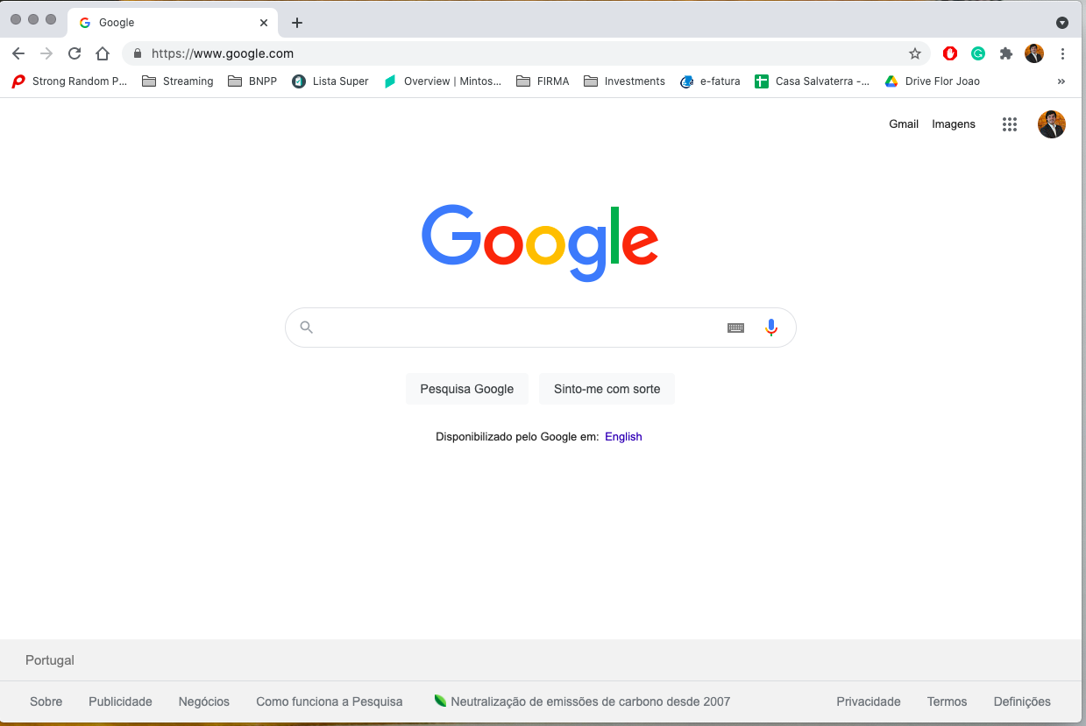
AM I SEEING DIRECTLY WHAT THE DEVELOPERS ARE DOING?

Slide 12


DEV vs PROD
Welcome

Slide 13
DEV vs PROD
Welcome

Slide 14

DEV vs PROD
Welcome

Slide 15
DEV vs PROD
Welcome

Slide 16

DEV vs PROD
Welcome

Slide 17
DEV vs PROD
Welcome

Slide 18
WHAT ABOUT DEPLOYING THINGS FROM ONE ENVIRONMENT TO THE OTHER?

Slide 19
DEV vs PROD
PROD
DEV
Welcome

Slide 20
DEV vs PROD
PROD
DEV
Welcome

Slide 21

DEV vs PROD - Gatekeeping
PROD
DEV
Welcome

Slide 22
BUT HOW DO WE “GIVE” WHAT WE JUST DID TO THESE PEOPLE?

Slide 23
BUT HOW DO WE “GIVE” WHAT WE JUST DID TO THESE PEOPLE?
THERE ARE ACTUALLY A FEW AWAYS

Slide 24

Role of GIT

Slide 25
Role of GIT
Welcome

Slide 26
Role of GIT
Welcome

Slide 27
Role of GIT
PROD
git commit
git push
git merge
DEV
Welcome

Slide 28
Role of GIT
PROD
Hey, it is ready to go
git commit
git push
git merge
DEV
Welcome

Slide 29
Role of GIT
PROD
git pull
git commit
git push
git merge
DEV
Welcome

Slide 30
HOW ABOUT MACHINE LEARNING MODELS?

Slide 31
HOW ABOUT MACHINE LEARNING MODELS?
We can use pickle files!

Slide 32
Role of GIT
PROD
Pickle file
(saved trained model)
git pull
git commit
git push
git merge
DEV
Pickle file
(saved trained model)
Welcome

Slide 33
BUT... I JUST NEED TO TELL A PERSON:
“PUT THIS IN PROD”... AND HE/SHE DOES IT?
WHAT’S THE POINT THEN?

Slide 34
Role of GIT
PROD
git commit
git push
git merge
DEV

Slide 35
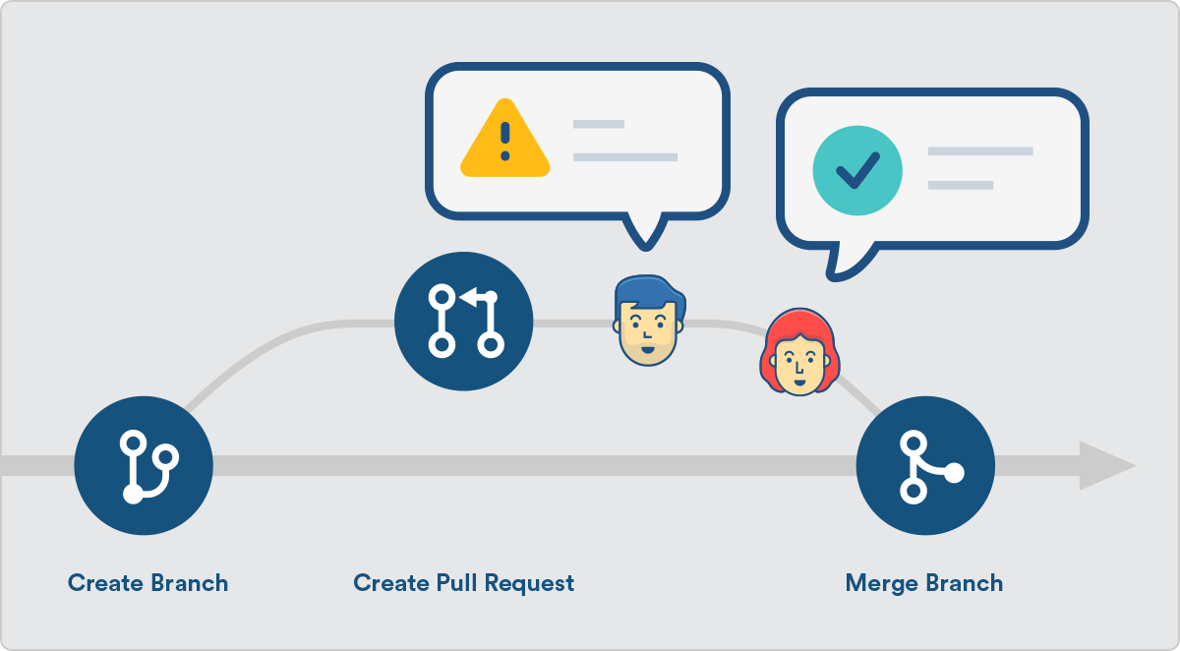
Role of GIT
PROD
CODE REVIEW:
PULL REQUEST
git commit
git push
git merge
DEV

Slide 36
Lets Review
PROD
More than one environment
DEVs cant put things in PROD
Before going to PROD, we need to make a code review
DEV

Slide 37
HAVING THIS IS REALLY GOOD!

Slide 38
HAVING THIS IS REALLY GOOD...
... HOWEVER, QUITE A FEW MANUAL STEPS: CAN WE MAKE IT BETTER?

Slide 39
CI CD

Slide 40
CI CD
SIGN OFF GIVEN THE RESULTS OF THE TESTS

Slide 41
Topics to look out for
Daily data
Daily data
Daily data
Daily data
PROD
Production Maintenance
DEV
Welcome

Slide 42
Topics to look out for
Production Maintenance
Complicated bureaucracy to deploy to production
Welcome

Slide 43
Topics to look out for
I created another env to test everything but I only work on Wednesdays
I have the mindset of 80 year old so I don’t give accesses to anyone
Production Maintenance
Complicated bureaucracy to deploy to production
We validate all changs that go into PRD
I am a senior in the team. Before pushing show me the code
Welcome

Slide 44
Topics to look out for
PROD
Production Maintenance
Complicated bureaucracy to deploy to production
Different infrastructure setup
pandas v0.25.12
(no numpy)
DEV
pandas v2.04.15
numpy v1.0.4

Slide 45
IS THERE REALLY NO WAY TO SOLVE
THIS LAST ONE?

Slide 46
Topics to look out for
PROD
Production Maintenance
Complicated bureaucracy to deploy to production
Different infrastructure setup
pandas v0.25.12
(no numpy)
DEV
pandas v2.04.15
numpy v1.0.4

Slide 47
Virtual Environments (venv)
PROD
Pandas v2
Numpy v24
Matplotlib v3
Requests v7
Pandas v14
Numpy v5
Matplotlib v9
Requests v1
Pandas v2
Numpy v24
Matplotlib v3
Requests v7
Pandas v14
Numpy v5
Matplotlib v9
Requests v1
DEV

Slide 48
”What about everything else besides Python packages:
SQL DB Setups, Drivers installed in Windows, etc?”

Slide 49


Slide 50
Thank you

